Slide 1

Welcome to YSJC!
Notes:
jennifer

Slide 2

TABLE OF CONTENTS
01
02
03
Introduction
Timeline
Program Tracks
04
05
06
Capstone Project
Groups
Q&A
Notes:
jennifer

Slide 3
01
Introduction
What is Youth STEM Journal Club?
Notes:
jennifer

Slide 4
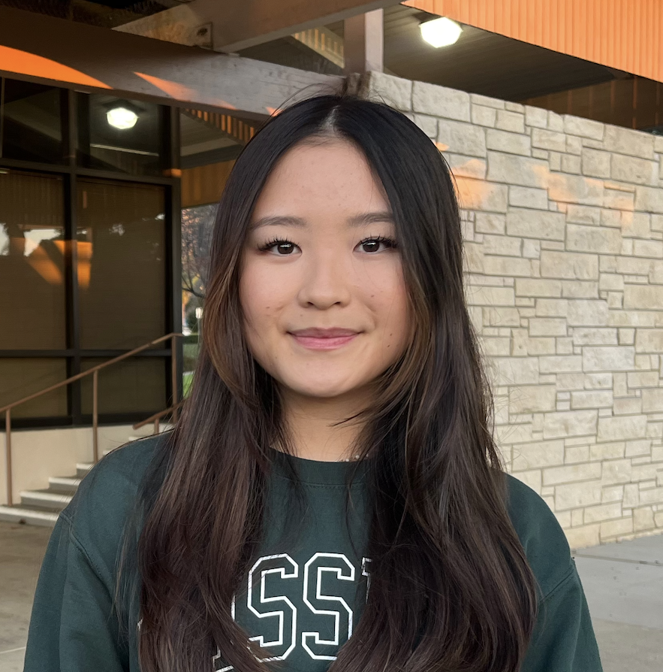
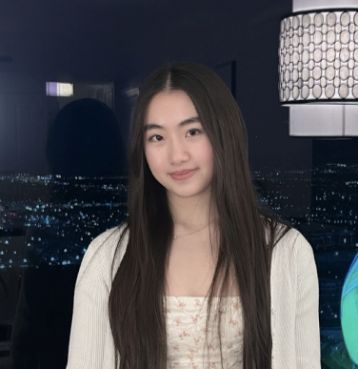
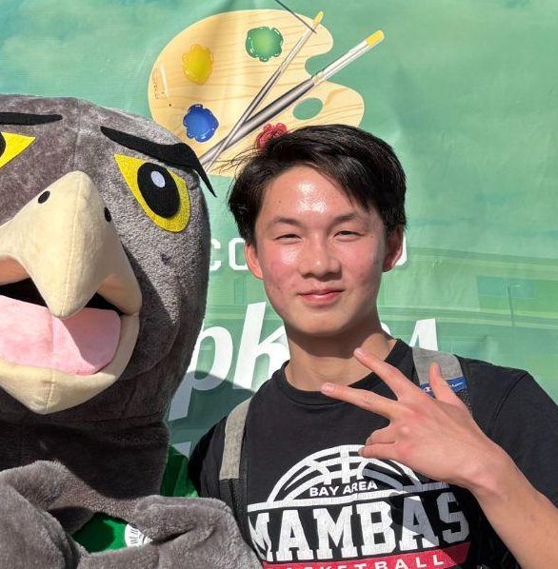
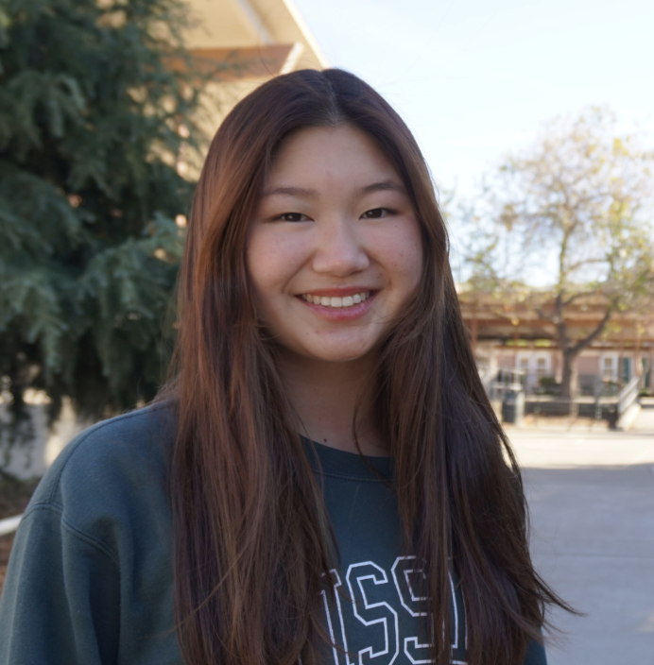
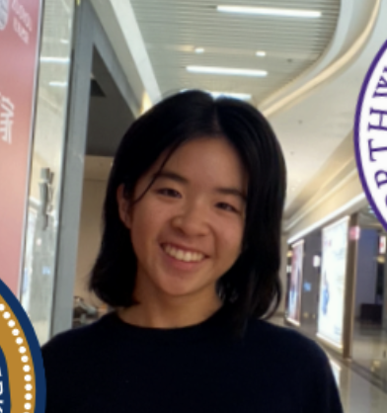
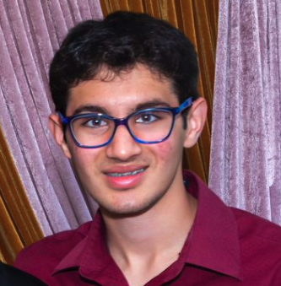
Meet the Mentors
Jennifer Li
Ashley Kang
Jadon Li
Kalena Dai
Stephanie Leung
Veer Mahajan
Neuroscience Group
Chemistry Group
Biology Group
Computer Science Group
Psychology Group
Mathematics Group
Notes:
jennifer

Slide 5
What is a Journal Club?
A journal club is a group that regularly meets to critically discuss scientific literature
Commonly found in colleges & higher education
“Journal Clubs are effective approaches in the training of [students] while exercising communication skills and critical thinking.” – Oxford Academic, 2024
Notes:
jennifer

Slide 6
Goals
Build fundamental research skills
Find and explore your interest in science
Learn how to approach complex ideas
Notes:
kalena

Slide 7
Program Components
Workshops
02
Group Meetings
01
Capstone Project
03
Covering a range of science related topics, open to all students, take place online
Guided discussions with mentors about readings (in-person & hybrid students)
Complete a capstone project and a final presentation
Notes:
Kalena
Will go into detail of everything during this meeting

Slide 8

Takeaways
Publication in YSJC’s Journal
Certificate of Achievement
Group & Individual awards
Head start on high school level science
Notes:
kalena

Slide 9

Timeline
02
Important dates + overview
Notes:
veer

Slide 10
Timeline
2nd Week(7/7-7/13)
4th Week(7/21-7/26)
01
02
03
04
05
1st Week(6/30-7/6)
3rd Week(7/14-7/20)
Presentation Day(7/26)
Getting Started with Research
Scientific Presentation + Communication Skills
Workshop 1: Dissecting Scientific Literature
Critical Thinking in Research + ISEF Judge Guest Speaker
Notes:
Veer
The workshops are for all students online in person or hybrid and parents are also welcome to listen in if they want
They will include lectures and various interactive activities
They are meant to supplement the students’ learning during the program and equip them with important skills
We will go more in depth for the presentation later

Slide 11
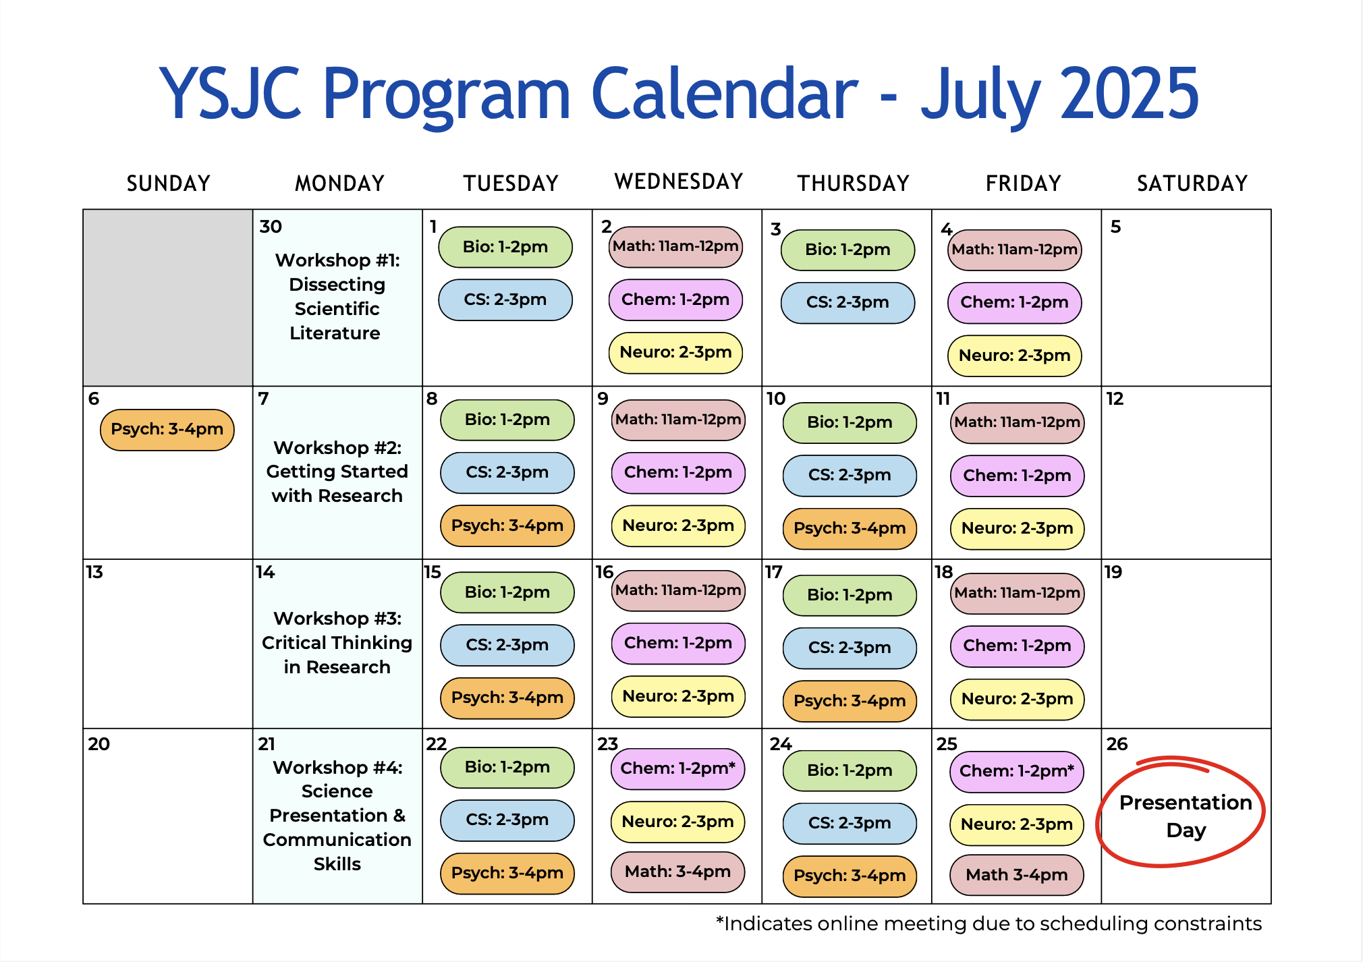
Notes:
Veer
The group meetings listed are for the in-person and hybrid track students only(we will talk about the tracks more in depth in a second)
Some groups have constant meeting dates but some have slightly different dates due to scheduling constraints to make sure to look over that and make sure it works for your own schedule

Slide 12
Tracks
03
Location & time logistics
Notes:
ashley

Slide 13
01
03
In-person
02
Online
Hybrid
For: students who are local in Fremont
Discussion & group environment learning
Two 1-hour group meetings with mentors per week for each group
Attend weekly online workshops with the rest of the students
For: students who are not local, cannot make the commute, or are traveling the full time
Readings, assignments, and analysis will be done asynchronously online on google classroom
Attend weekly online workshops with the rest of the students
For: students who are interested in attending in-person but have extended time constraints/travel
Attend at least 4 of 8 in-person group meetings
Complete asynchronous online readings & assignments for missed meetings
Attend weekly online workshops with the rest of the students
Notes:
Ashley
Suggest the in-person track as the most optimal if they are able to because it encourages discussion and interaction to get the most out of the program
Online students can come to present in-person if possible or join online, coordinate this with groups and mentors
All students will join a google classroom where they can access assignments and communicate
Emphasize that the journal club is not strictly a course and there’s no tests or grades but it’s still important to stay on top of work and such

Slide 14

Capstone Project
04
Notes:
jadon

Slide 15

Capstone Project Details
Part A: Literature Review Article
Part B: Final Presentation
Write a literature review article with your group & mentor throughout the month providing a comprehensive synthesis of one of your group’s papers
Purpose: to give you an idea of how to write about complex scientific topics in research
Your article will be edited and reviewed by mentors, then compiled into a YSJC Journal, which will be distributed during our final presentation session and displayed for access on the website
All students(online, in-person, hybrid)
Groups divide into two subgroups to present each paper
Purpose: Demonstrate your learning to an audience
In-person: Saturday July 26th 1-3 pm at the Newark Library Community Meeting Room
Parents, family, friends are welcome to attend
Guest speakers: science fair judge, research advisor
Write a
Notes:
jadon
Literature reviews are important parts of scientific literature at all levels
Part A purpose: helps gain skills for writing original research papers in the future
More details about the capstone project will be in a guidelines document in our google drive that can be accessed at the end of this meeting

Slide 16

AI Policy
Welcome and encouraged to utilize AI as a tool to supplement learning
However, if it’s used for writing or replacement of genuine work, you will not be permitted to present or publish your work
Integrity > enforcement
Notes:
Stephanie
We are high school juniors and seniors and are therefore extremely familiar with AI and can tell what is and isnt chatgpt not like some old teachers(relatable vibes like been there done that)
You get out from this program what you choose to give in which is how a lot of things work in high school so prioritize learning over getting it over with

Slide 17

Subject Group Introductions
05
Which STEM subject do you want to pick?
Notes:
Stephanie
Slideshows will be in the google drive so they can come back to them
Also check out the syllabi in the drive

Slide 18
Onboarding materials checklist
Forms to fill
Documents for Review
All materials are in the google drive
Group Sign-up Form(due 6/20)
Liability Waiver & Class Rules agreement
Pre-program survey
Program Outline
Capstone Project Guidelines
Group syllabi
Notes:
jennifer

Slide 19
Group placement
Groups are assigned based on ranked interest & open spots
First choice group is not guaranteed
If a group fills up quickly, sign ups will be first come first serve
In-person sign-ups are given priority
Sign up form opens after this meeting and will close on Friday, 6/20 11:59pm
Group placements will be sent out on Monday, 6/23
Notes:
jennifer

Slide 20
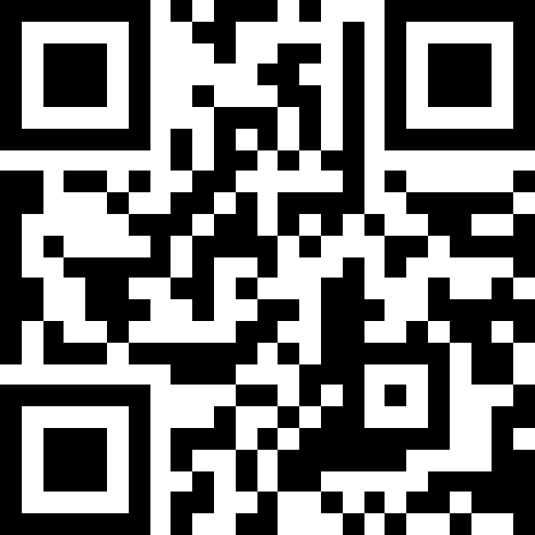

Q&A
Drive with all program materials: tinyurl.com/ysjcdrive
Notes:
kalena

Slide 21

Thank you!
Notes:
Kalena

